Slide 1
We have had a recall!
Gibson received some improperly treated wood and is recalling some Les Paul models. Our product # 2 is one of the models.

Slide 2
Product ID 2
List of all customers that have purchased this product
This list should include the date of purchase and the invoice number, as well as the relevant customer information

Slide 3
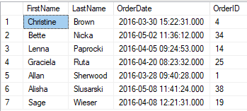

Slide 4

Product ID 2
How many customers are affected?

Slide 5
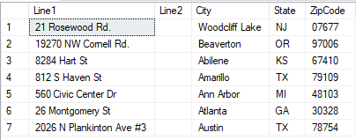
Product ID 2
List of mailing addresses of affected customers

Slide 6

Product ID 2
List of the total amount spent by customers on this product

